Slide 1


Bidirectional Attentive Memory Networks for Question Answering over Knowledge Bases
Presenter: Yu Chen
Computer Science Department
Rensselaer Polytechnic Institute, Troy, NY 12180
Joint work with Lingfei Wu & Mohammed J. Zaki
Notes:
15+3’

Slide 2
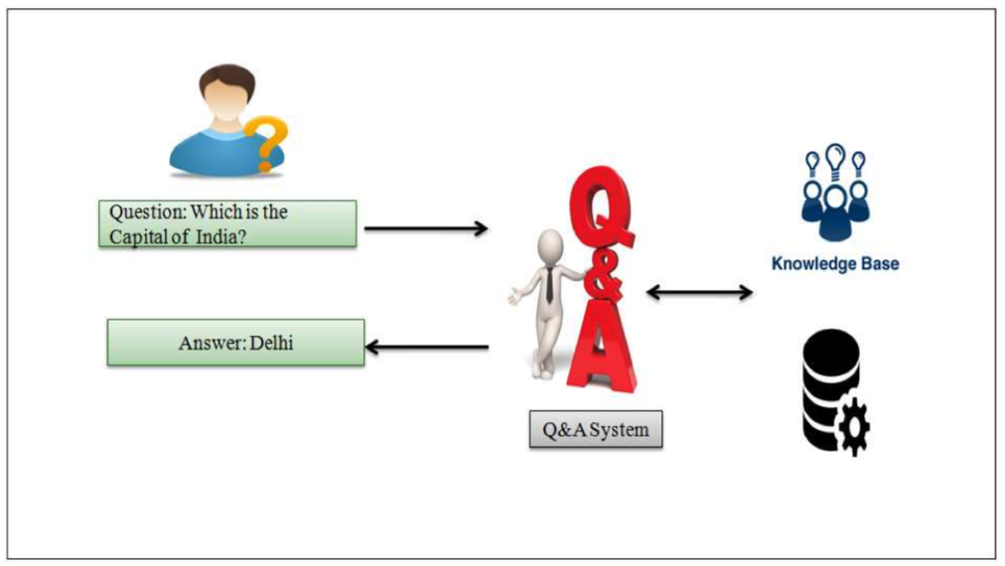
Task Definition
Given questions in natural language (NL), the goal of KBQA is to automatically find answers from the underlying KB.
Notes:
http://wjter.com/Research%20Papers/January%202018/PDF/Survey%20on%20Community%20Question%20Answering%20Systems.pdf

Slide 3
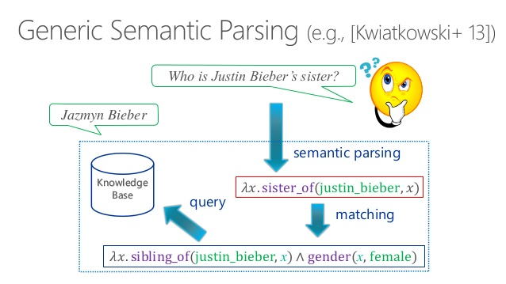
Semantic Parsing-based Approaches for KBQA
Converting NL questions into intermediate logic forms, which can be further executed against the underlying KB.

Slide 4
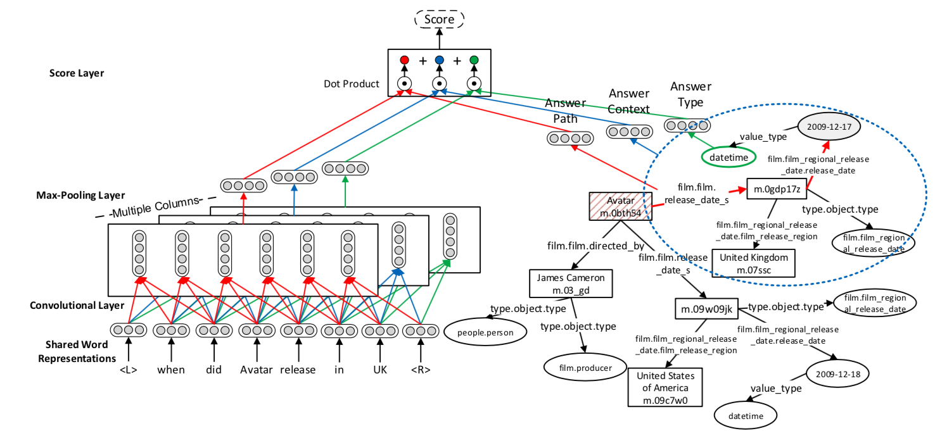
Information Retrieval-based Approaches for KBQA
Directly retrieving answers from the KB by mapping questions and KB into the same embedding space and ranking answers based on the matching scores between a question and the candidate answers.
Dong, Li, et al., 2015
Notes:
Dong, Li, et al. "Question answering over freebase with multi-column convolutional neural networks." Proceedings of the 53rd Annual Meeting of the Association for Computational Linguistics and the 7th International Joint Conference on Natural Language Processing (Volume 1: Long Papers). Vol. 1. 2015.

Slide 5
SP-based vs. IR-based Approaches
Most SP-based approaches require
annotated logical forms as supervision, or
hand-crafted rules/features to prune the program search space.
Most IR-based approaches
require no or very few hand-crafted rules/features.
End-to-end trainable.
Notes:
(1’)

Slide 6
Typical IR-based Approaches for KBQA

Slide 7
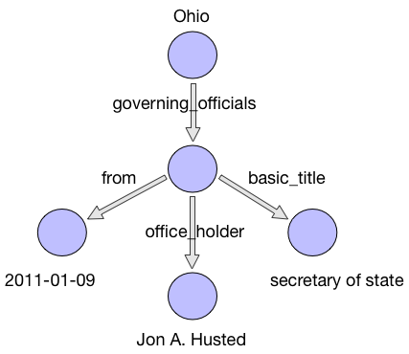
Fetching answers from a KB subgraph
Topic entity linking
Question: who is the secretary of Ohio
in 2011?
Nodes within a k-hop KB subgraph are considered as candidate answers.
Figure 1. A 2-hop KB subgraph from FreeBase.

Slide 8
Encoding KB Subgraphs
For each candidate answer from the KB subgraph, we encode three types of information:
Answer type: entity type of the candidate answer.
Answer path: a sequence of relations from the candidate answer to the topic entity.
Answer context: surrounding entities of the candidate answer.
Answer type: PERSON
Answer path: [office_holder, governing_officials]
Answer context: {2011-01-09, secretary of state}
Notes:
(2’)

Slide 9
Bidirectional Attentive Memory Network

Slide 10
Motivation
Most existing IR-based methods encode questions and KB independently without considering the inter-relationships between them.
When answering NL questions over a KB, different question components and KB aspects play different roles.
Query: Who did France surrender to in ww2?
KB aspects: entity type, relation path, context.
Notes:
(1’)
distill the information that is the most relevant to answering the questions on both sides of the question and KB.

Slide 11
Motivation (cont’d)
We propose to directly model the two-way flow of interactions between the questions and the KB via a novel Bidirectional Attentive Memory Network (BAMnet).
Our method generally models the bidirectional interactions between one body of text and a KB.
Notes:
(1’)
distill the information that is the most relevant to answering the questions on both sides of the question and KB.

Slide 12
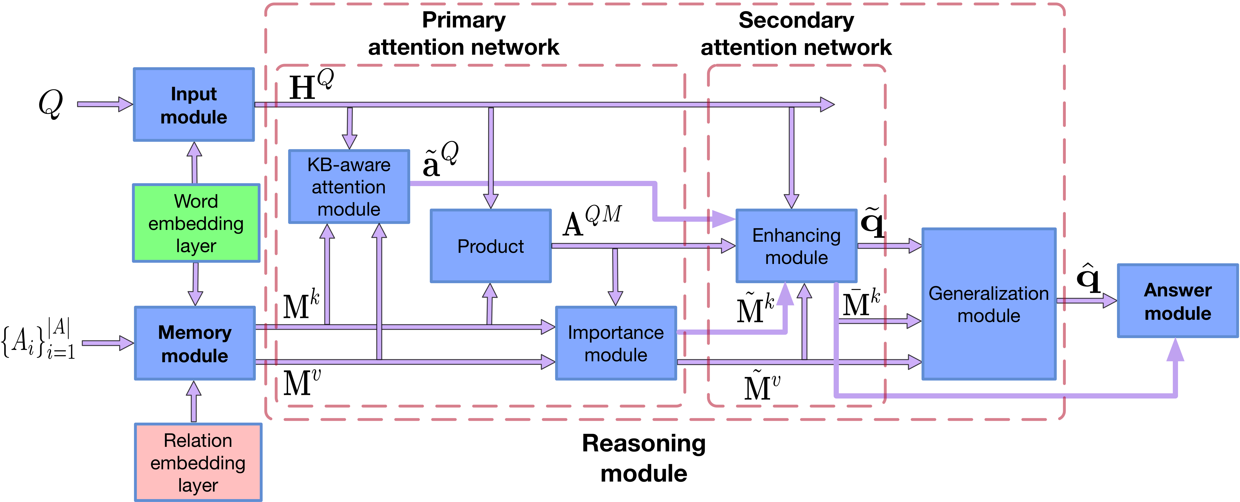
Overall Architecture of the BAMnet Model
Input module
Encoding the input question.
Memory module
Encoding candidate answers.
Employing a key-value memory to store candidate answers.
Reasoning module
Updating question and candidate answer representations.
Answer module
Ranking candidate answers based on their matching scores with the question.
Notes:
(1’)

Slide 13
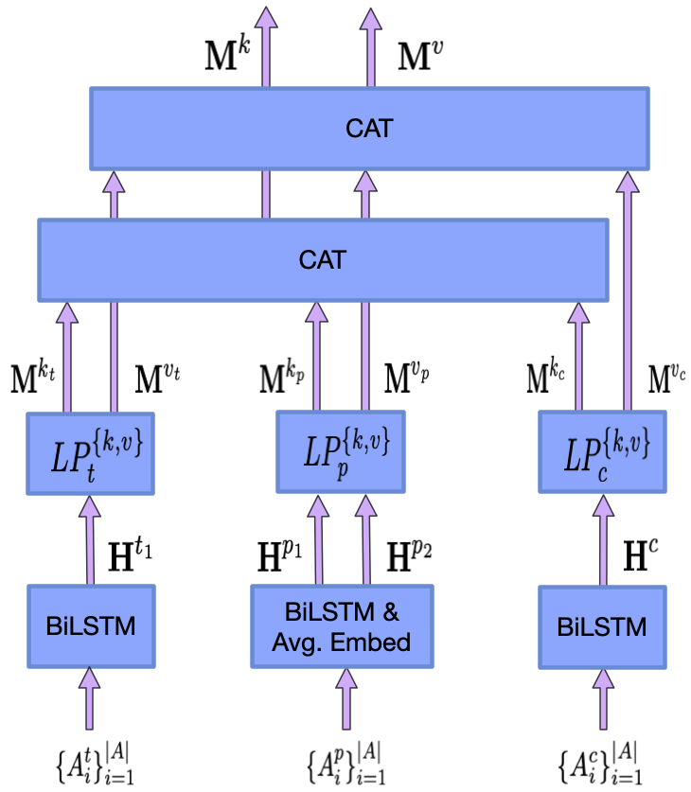
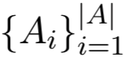
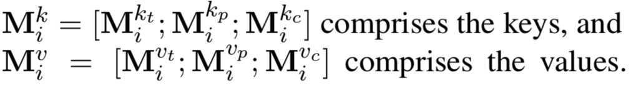
Key-Value Memory Network to Store Candidate Answers
Memory networks are neural networks equipped with a long-term memory component that can be read from and written to.
Unlike a basic memory network, in a key-value memory network, the addressing stage is based on the key memory while the reading stage uses the value memory.
We use a KV memory network to store candidate answers .
Notes:
(1’)

Slide 14
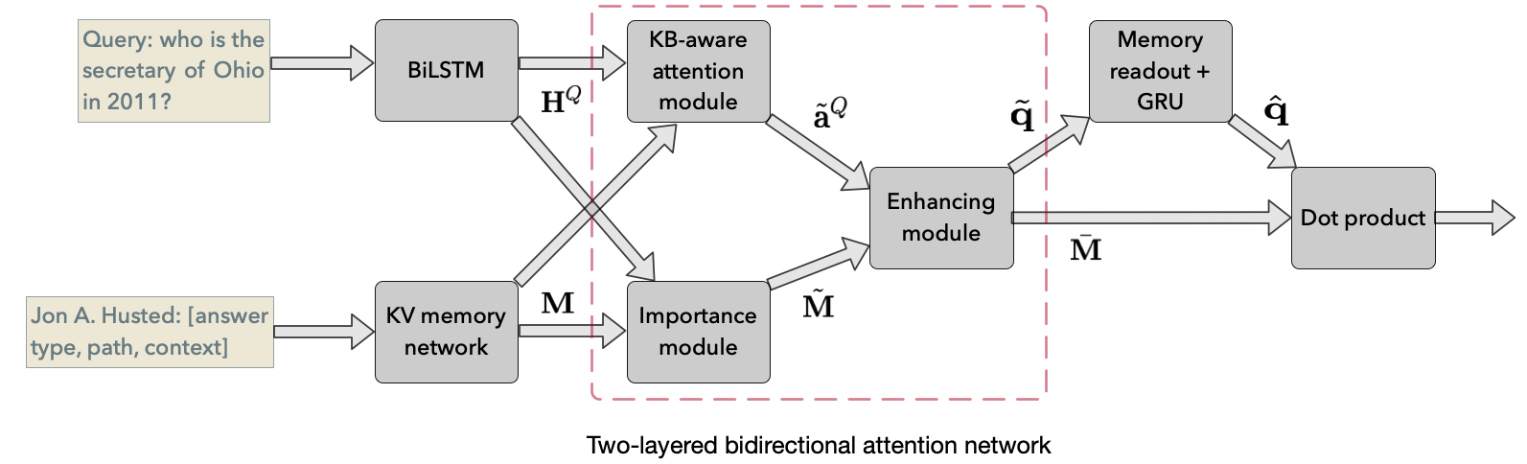
Two-layered Bidirectional Attention Network
Primary attention network
KB-aware attention module
Focusing on important question parts.
Importance module
Focusing on important KB aspects.
Secondary attention network
Enhancing KB and question representations via two-way attention.
Notes:
(1’)

Slide 15
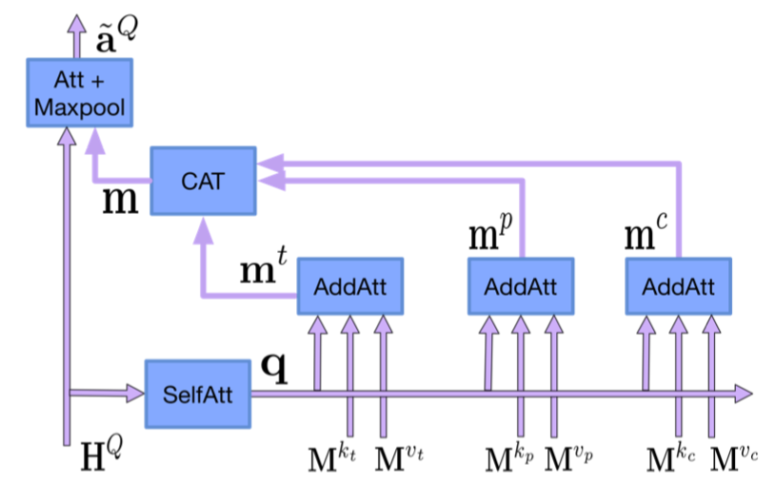
KB-aware Attention Module
Goal
Focusing on important question components.
Motivation
Each word in a question serves a specific purpose.
The importance of question components depends on the KB!
Not all KB triples are equally helpful for detecting important question components. Only those relevant to the question are!
Our solution
Computing a question summary q using self attention.
Computing a summary for each of the KB aspect, i.e.,
answer type m_{t}, path m_{p} and context m_{c .}
Computing the question-to-KB attention (i.e., a |Q| by 3 matrix)
between each question word and KB aspect.
4) Applying max pooling over the KB aspect dimension of the
question-to-KB attention to get an attention vector
over the question words.
Notes:
(1’)
The idea behind it is that each word in a question serves a specific purpose (i.e., indicating answer type, path or context), and max pooling can help find out that purpose.
It is a KB-aware question attention vector since it indicates the importance of qi in light of the KB.

Slide 16
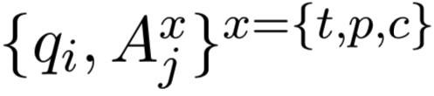
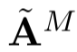
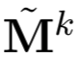
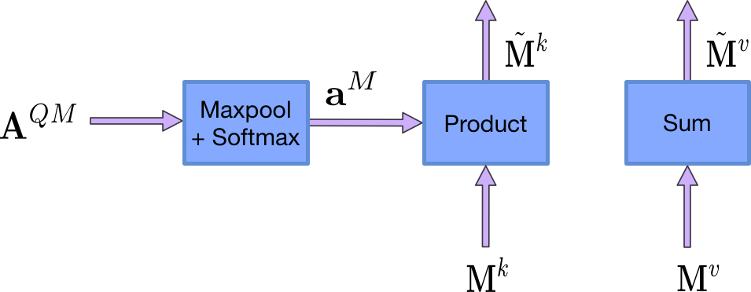
Importance Module
Goal
Focusing on important KB aspects.
Motivation
The importance of KB aspects is measured by their relevance to the question.
Our solution
Computing a |Q| × |A| × 3 attention tensor A^{QM} which indicates the strength of connection between each pair of .
2) Taking the max of the question word dimension of A^{QM} and normalize it to get a |A| × 3 attention matrix , which indicates the importance of each answer aspect for each candidate answer.
3) Computing question-aware memory representations .
Notes:
(1’)

Slide 17
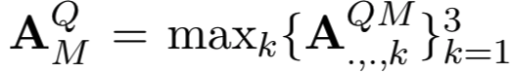
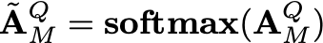
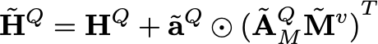
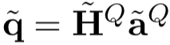
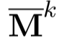
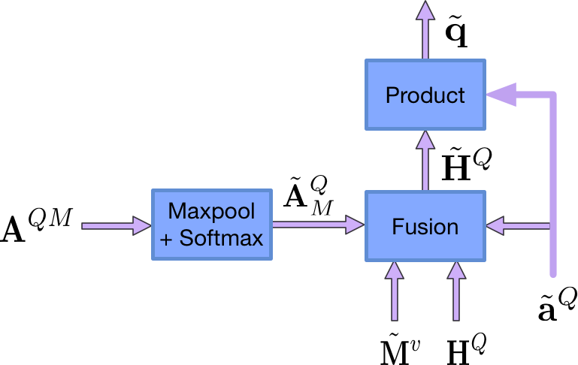
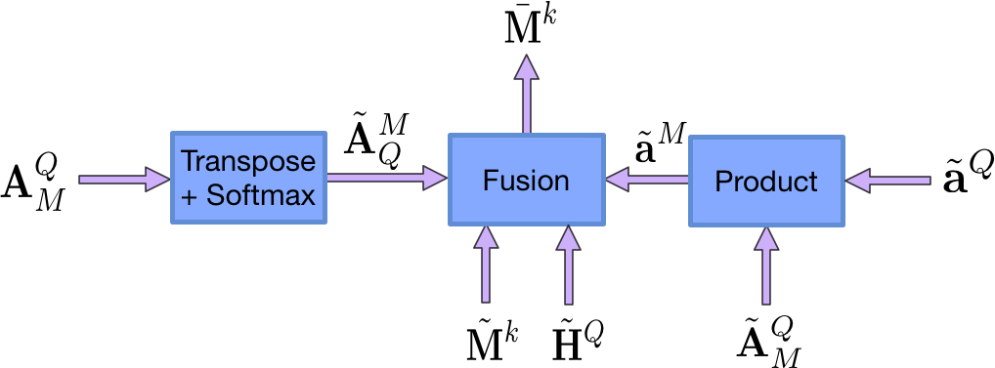
Enhancing Module
Goal
Enhancing the question and KB representations by exploiting the two-way attention.
Our solution
Computing a question-KB attention matrix by applying max pooling over the answer aspect dimension of A^{QM},
Computing the question-aware KB summary and incorporating it into the question representation
Obtaining a KB-enhanced question vector .
Similarly, we compute a question-enhanced KB representation which incorporates the relevant question information.
Notes:
(1’)

Slide 18
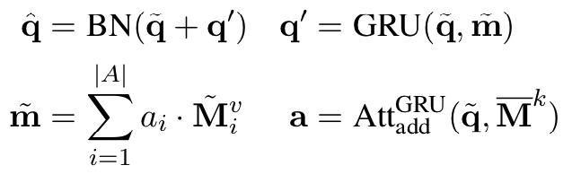
Generalization Module
The generalization step is a default step in memory networks.
We use the query representation to address the key memory, and retrieve the value memory to update the query representation.
We apply skip-connection and batch normalization when updating the query representation.

Slide 19
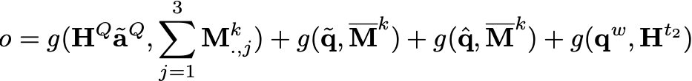
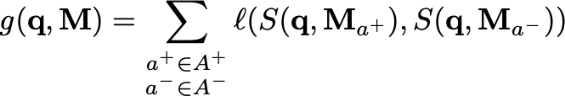
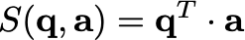
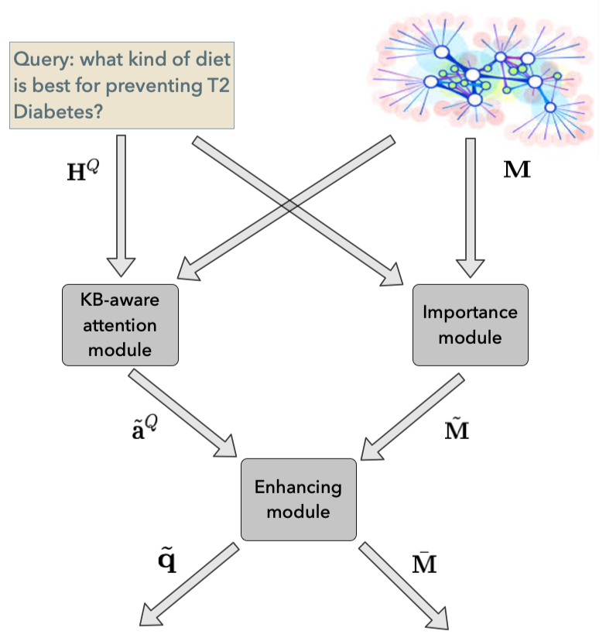
Training
Loss function
We force positive candidates to have higher scores than negative candidates by using a triplet-based loss function.
where and is a hinge loss. and denote
the positive (i.e., correct) and negative (i.e., incorrect) answer sets, respectively. is a matching function which computes the dot product between question and candidate representations.
Sampling candidate answers
We extract the KB subgraph surrounding the gold topic entity.
We randomly sample candidates from the KB subgraph.
Notes:
Intermediate modules such as the enhancing module generate “premature” representations of questions (e.g., q ̃) and candidate answers (e.g., Mk).
Even though these intermediate representations are not optimal for answer prediction, we can still use them along with the final representations to jointly train the model,
which we find helps the training probably by providing more supervision since we are directly forcing intermediate representations to be helpful for prediction.

Slide 20
Prediction
We extract all the candidates from the KB subgraph surrounding the predicted topic entity (returned by a topic entity predictor).
We compute the matching score (dot product) between every pair of (question, candidate).
The candidates are then ranked by their scores.
We apply certain threshold to only return a list of most likely answers.
Notes:
(2’)

Slide 21
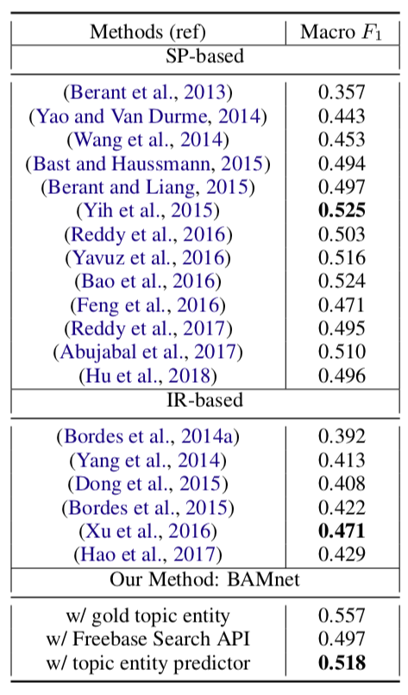
Experiment Results
WebQuestions
3,778 training and 2,032 test examples
An example comprises
Natural language utterance
Answer provided by Mturk workers
Freebase URL for the answer (topic entity)
About 85% questions can be answered via a single Freebase predicate
Questions can have multiple answers.
Freebase
Facts in RDF triples: subject-predicate-object
41M Entities, 19K Properties, 596M Assertions
Table 1. Results on WebQuestions test set. Bold: best in-category performance.
Notes:
our method significantly outperforms previous IR-based methods while remaining competitive with hand-crafted SP-based methods.
Gap of topic entity linking, If we assume gold-topic entities are given then BAMnet achieves an F1 of 0.557.

Slide 22
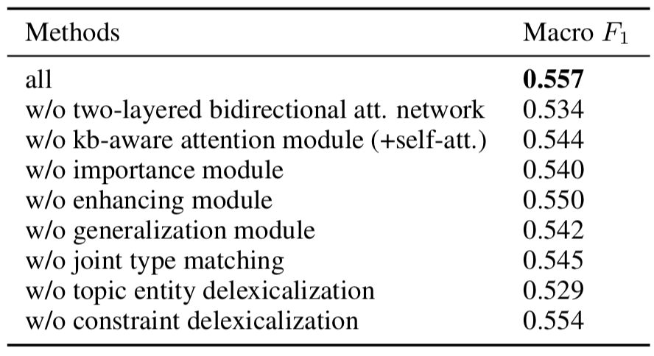
Ablation Study
How do the different modules impact performance.
Two-layered bidirectional attention network is important.
Importance module (i.e., query-to-KB attention flow)
KB-aware attention module (i.e., KB-to-query attention flow)
Topic entity delexicalization is important.
Table 2. Ablation results on WebQuestions. Gold topic entity is assumed to be known.
Notes:
Note that gold topic entity is assumed to be known when we do this ablation study, because the error intro- duced by topic entity prediction might reduce the real performance impact of a module or strategy
significant performance drops were observed after turning off some key attention modules, which confirms that the real power of our method comes from the idea of hierarchical two-way attention.
when turning off the two-layered bidirectional attention network, the model performance drops from 0.557 to 0.534.

Slide 23
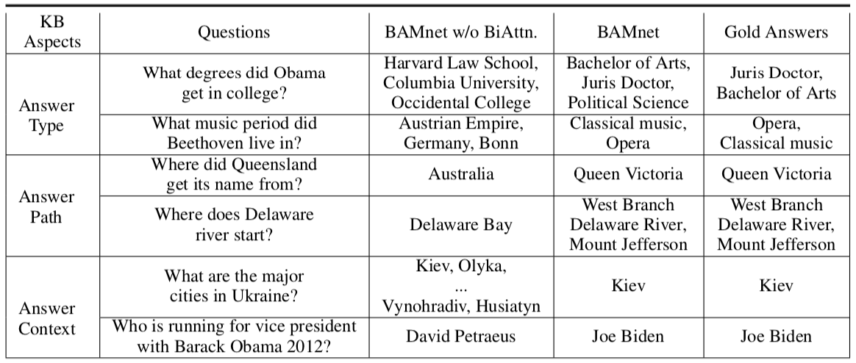
Interpretability Analysis
Table 3. Predicted answers of BAMnet w/ and w/o bidirectional attention on the WebQuestions test set.
Notes:
We divide the questions into three categories based on which kind of KB aspect is the most crucial for answering them.
compared to the simplified version which is not equipped with bidirectional attention, our model is more capable of answering all the three types of questions.

Slide 24
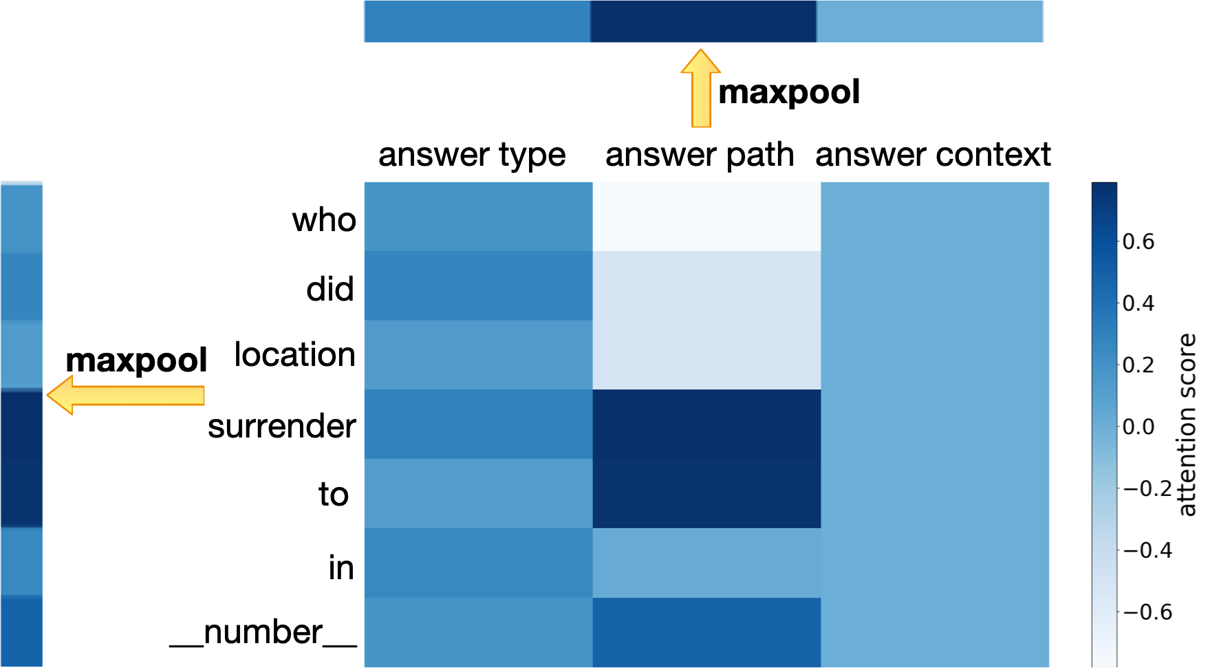
Interpretability Analysis (cont)
Figure 1. Attention heatmap generated by the reasoning module.
Notes:
(2’)
the attention network successfully detects the interactions between “who” and answer type, “surrender to” and answer path, and focuses more on those words when encoding the question.

Slide 25
Conclusions and Future Work
Most existing embedding-based methods for KBQA ignore the subtle inter-relationships between the question and the KB.
We proposed to directly model the two-way flow of interactions between the questions and the KB.
Our method significantly outperforms previous IR-based methods while remaining competitive with hand-crafted SP-based methods on a popular KBQA benchmark.
Both ablation study and interpretability analysis verify the effectiveness of the idea of modeling mutual interactions.
In the future, we would like to explore effective ways of modeling more complex types of constraints (e.g., ordinal, comparison and aggregation).
Notes:
(1’)

Slide 26
Thank you!
Q&A
Code: https://github.com/hugochan/BAMnet

Slide 27
Topic Entity Prediction
Goal
Given a question, the goal of topic entity prediction is to find the best topic entity from the candidate set returned by external topic entity linking tools.
Motivation
We know an entity better by looking at its KB subgraph.
E.g., an entity “Apple” with type “ORGANIZATION” and surrounding relations “founder”, “CEO”, etc.
Our solution
Encoding the question into a vector.
Encoding each candidate (i.e., entity name, entity type and surrounding relations) into a vector.
Employing a memory module to store candidates.
Applying the aforementioned generalization module to update the question representation.
Training:
We force positive candidates to have higher scores than negative candidates by using a triplet-based loss function.
Testing:
The candidate with the highest score is returned as the best topic entity.

Slide 28
Error Analysis
We randomly sampled 100 questions on which our method performed poorly and categorized the errors.
label issues of gold answers (33%)
E.g., incomplete and erroneous labels, and also alternative correct answers.
Constraints errors (11%)
Temporal constraints account for most.
Type errors (13%)
Our method generates more answers than needed because of poorly utilizing answer type information.
Lexical gap (5%)
Other sources of errors (38%)
E.g., question ambiguity, incomplete answers and other miscellaneous errors.

